Slide 1
A Brief Instruction of The Interactive Map
Shuo Chen
20/08/2023

Slide 2
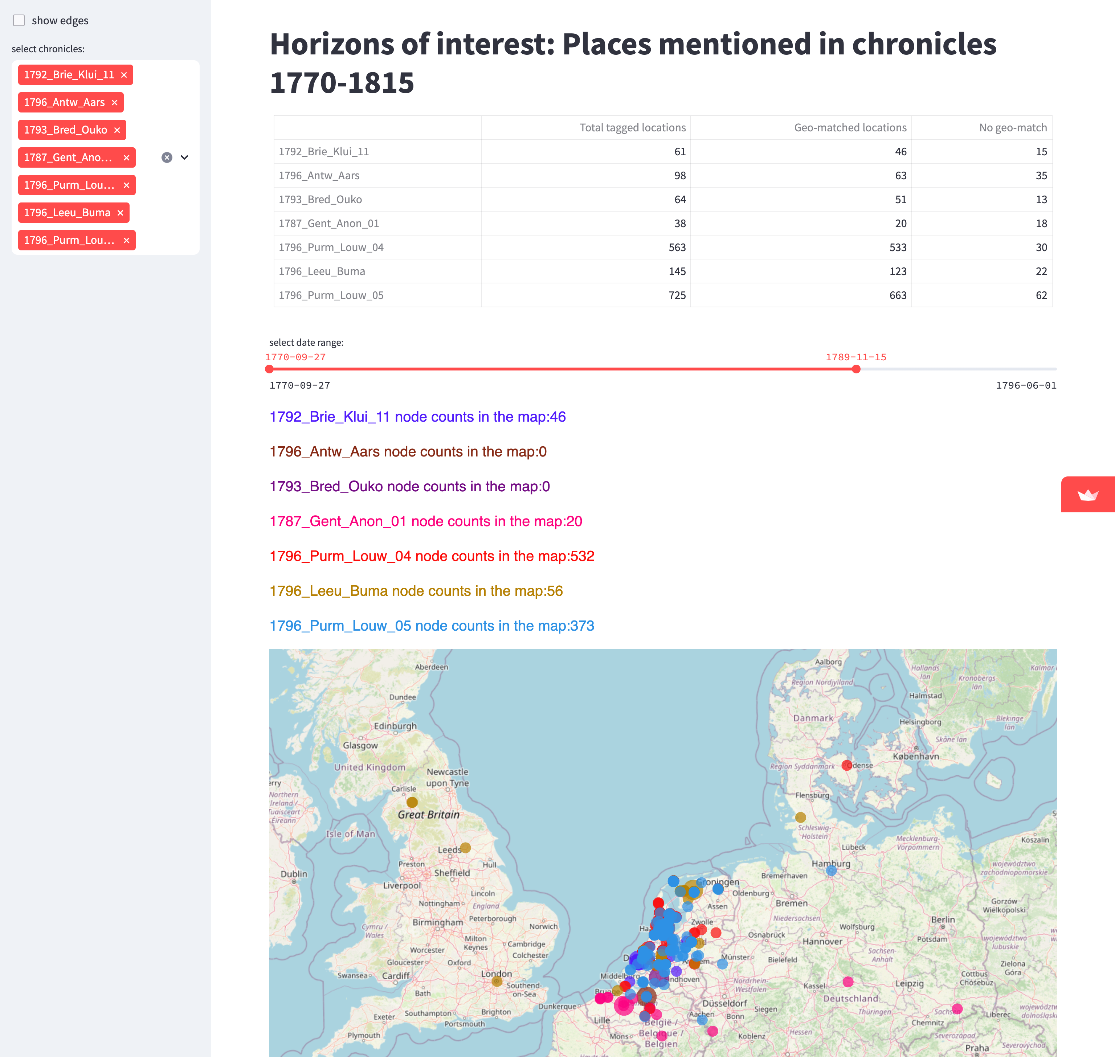
Tick the box to show edges.
Summary of the places in shown chronicles. No geo-match suggests the geoname IDs are unavailable for the places.
Choose the chronicles you’d like to present in the map
Drag the sidebar to select specific date range
The colors of the chronicles correspond to the node colors shown in the map below
the dots on map present the places mentioned in the chronicles

Slide 3
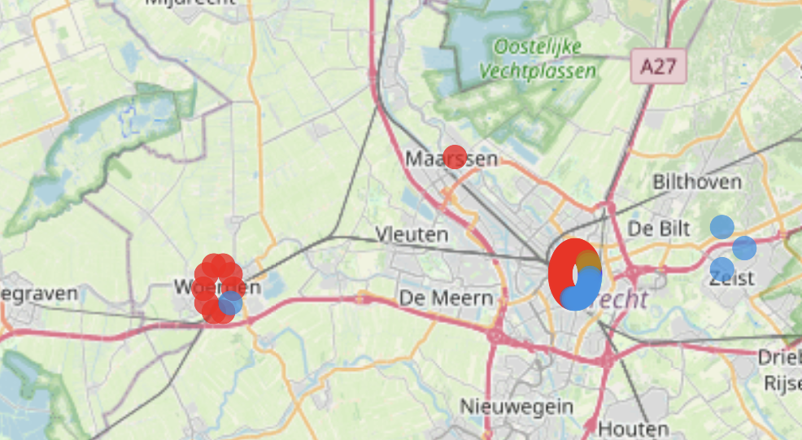
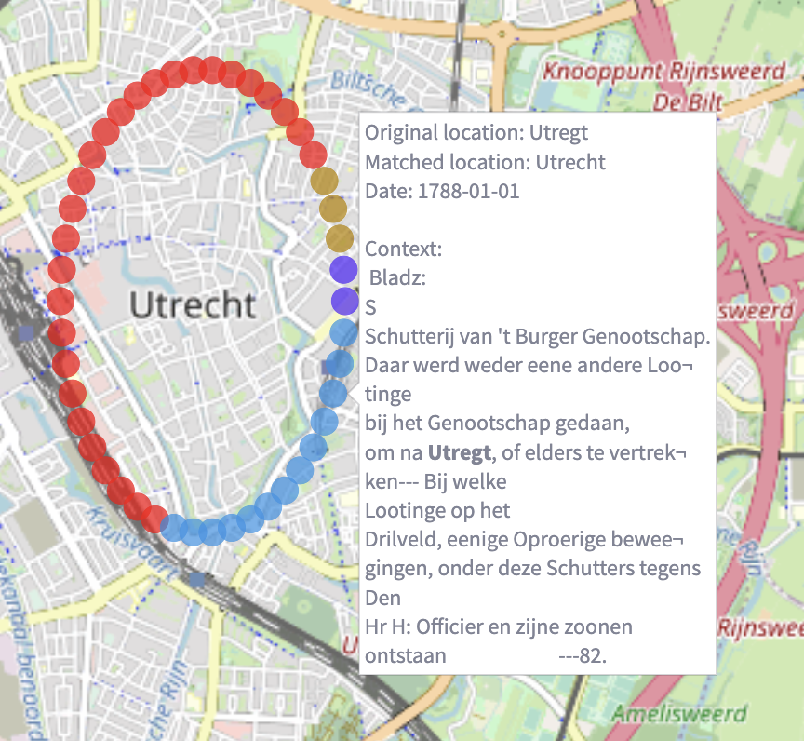
Zoom in or zoom out the map to see the detail or overall view.
The node on map present a place mentioned in the chronicle. Hover the mouse over the node to see the chronicle context which mentions the location. The hover information includes: - original location name - matched modern location name - the date when the context is written - the context of this location
Different node color indicates different chronicles. In the example on the left, Utrecht is mentioned by 4 different chronicles many times, resulting repeated locations. In these cases, the repeated locations are arranged to surround the actual Utrecht location’s geo-coordinates (latitude and longitude) and form a circle. The nodes on circle is ordered by chronicles, and within the same chronicle, the nodes are sorted by dates.
zoom in

Slide 4
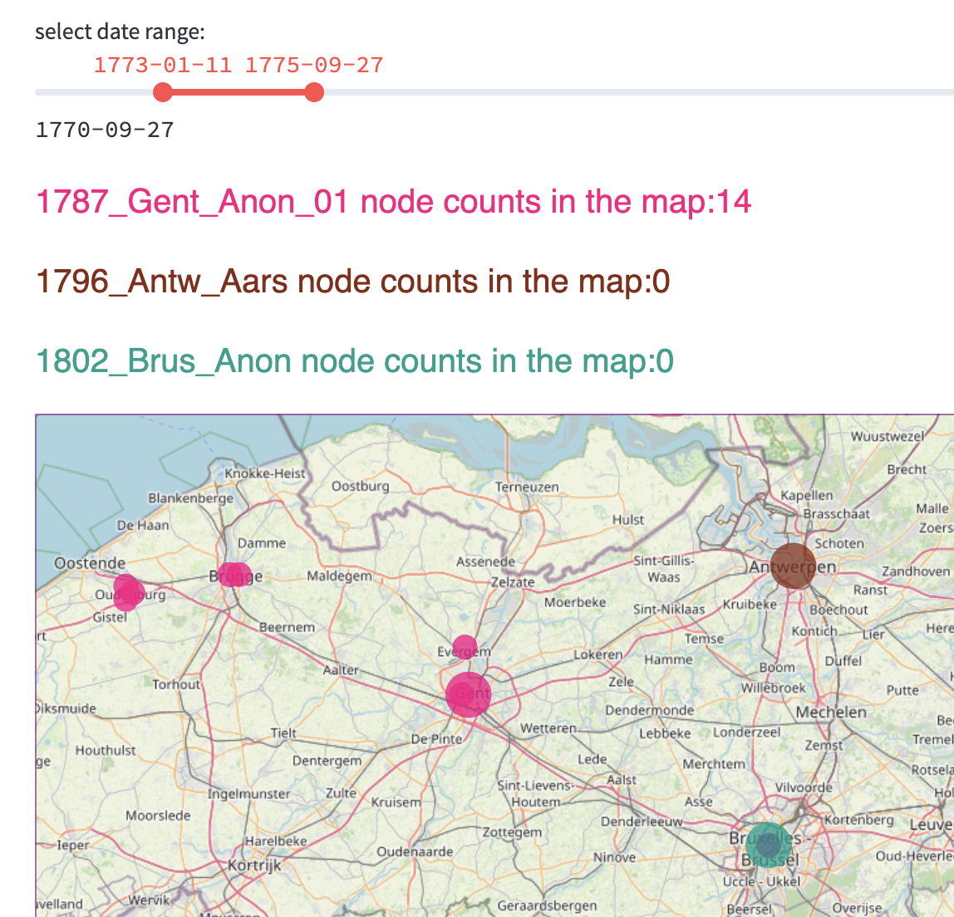
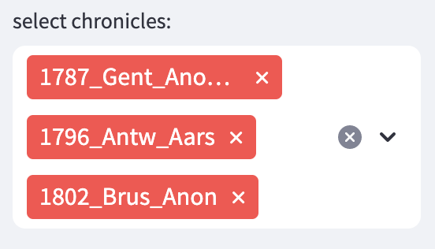
There are larger node indicates where the chronicle is written, assigned by different colors.
Once the chronicle is selected at sidebar, the larger node will appear.

Slide 5
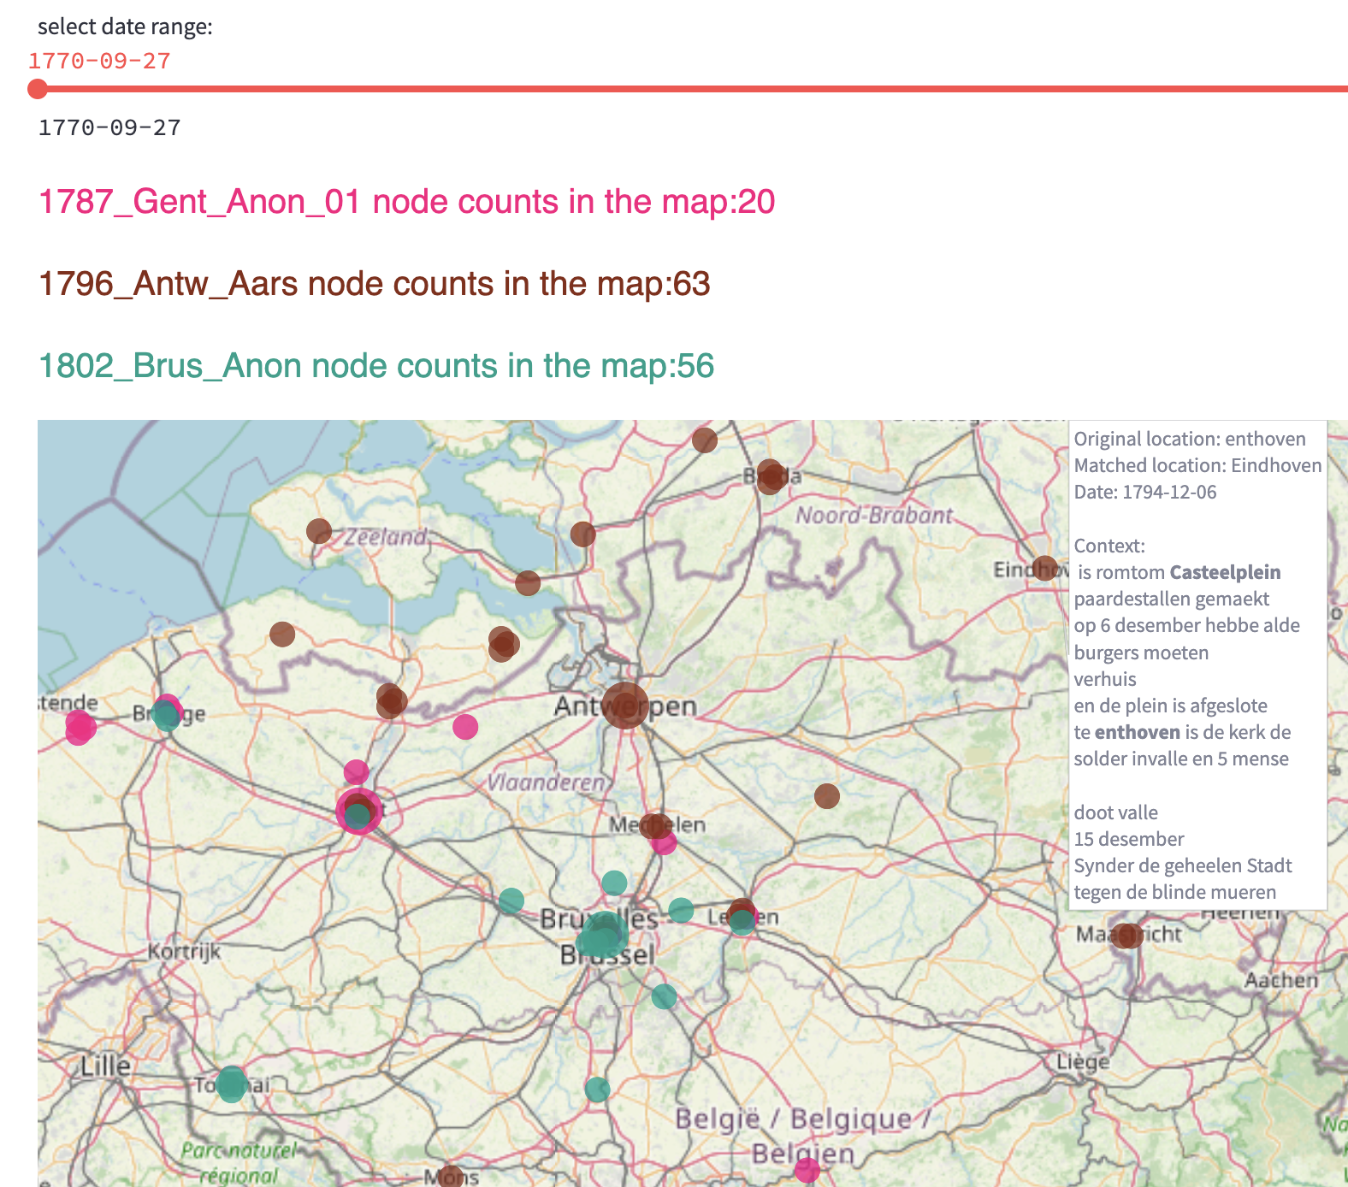
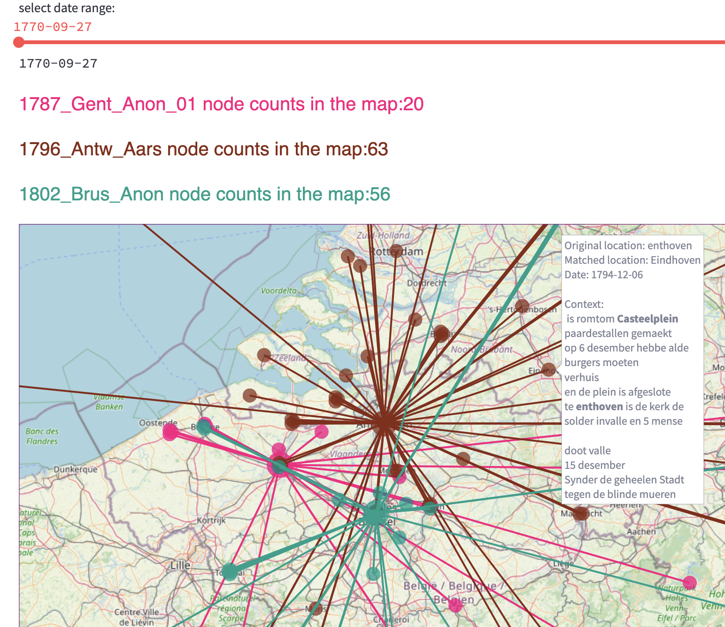
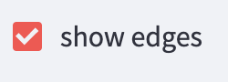
After adding edges by ticking the “show edges” box, the nodes from same chronicle will connect to the location where this chronicle is written (the larger node)
If there are too many nodes on the map, it will take some time to show the map.
Play with the map to see the location’s pattern in one chronicle, or the connections among multiple chronicles during a selected date range.

